Slide 1
MSc Consulting + Finance & Technology Club Case Competition
Microsoft Case: Case Outline & Dataset Outline

Slide 2
Student Objectives
Students will be asked to make a strategic recommendation for Microsoft regarding products in the Asia-Pacific region. The two general paths to a “solution” are:
As
Focus on personal computing, specifically the new “Surface” product
Invest in cloud products, which are projected to see massive growth globally
Strong presentations will:
As
Offer a recommendation on product focus and the product’s target market
Outline a high-level strategy for that product and the target market
Justify their recommendation and strategy using both quantitative (data + financials) and qualitative analysis (competition, customers, capabilities, etc.)

Slide 3
Key Case Facts
Case takes place at year-end 2017, focusing on Asia-Pacific market strategy
Two products of focus for strategy: PC business and cloud services
Personal Computing Business:
As
Traditional PC hardware business model under threat by growing competition, maturing industry; revenues fell 6% in 2016
Surface products launched in 2012 to combat this: flexible and mobile laptop/tablet product (“inclusion design”, considering all possible end-consumer needs from product inception)
Consumers increasingly desire “seamless usage across different devices”; bridge gap between work/life
Microsoft may need to aggressively tap into these changing market dynamics to protect its existing PC business, which shows signs of erosion
Asia-Pacific region seeing high growth, high opportunity; distribution channels, marketing, language customization remain question marks for company
Cloud Services Business:
As
High growth yet high risk opportunity; outside of Microsoft’s traditional business, though company has a solid start with Azure (suite of cloud services)
Various applications (data management + storage, predictive modelling, business intelligence) not limited to a single industry
Highly competitive industry (AWS, Alibaba, Microsoft combined > 50% market share) with many smaller start-ups threatening market share
Asia-Pacific set to see Infrastructure as a Service (IaaS grow 36% YoY in 2017, surpassing Software as a Service (SaaS) for the first time; large companies in region starting to undergo digital transformation

Slide 4
Data Set Introduction
Students will be provided with a sample data set of 10,000 existing Microsoft enterprise customers, each of which has three years (2015/16/17) of revenue data (30k rows total)
The data was designed by us, the event organizers, to provide students with extra quantitative depth to justify their solutions, and practice new data skills learned in the MSc program
60% of students signed up are Business Analytics students in the new MSc cohort; most have ~2 months of data skills – so set data analysis expectations accordingly!
Data on companies includes some basic demographics (country of headquarters, sector, workforce size), as well as financial information (revenues from various product + service lines, estimated IT budget in each year); designed for business intelligence rather than modelling
Demographic Variables
Financial Variables (2015-2017)
Enterprise ID | Enterprise Country Hq | Enterprise Sector | Workforce Size
 | China | Financial Services | From 0 to 1000+
 | India | Technology & Consulting
 | Singapore | Healthcare
 | South Korea | Education
 |  | Other
Cloud Service Revenues
Non-Surface Product Revenues
Surface Product Revenues*
Office Revenues
Other Revenues
IT Budget Estimate
*It is stated in the case that Surface is introduced to China in 2017; for the sake of the data, we are telling students to assume Surface products were introduced to the Asia-Pacific region in 2014.

Slide 5
Data Set: Sample Analysis
The data is basic, but has enough depth to help inform decisions on each respective product strategy – there is no “right” answer, but there is data to favour some answers over others
Data analysis will be one small piece of a good presentation (especially since data is strictly for enterprises, excluding retail markets) – the actual strategy that is informed by the data is at least as important
The following slides offer a sample of some basic analysis through use of the data that might inform strategy:
A

Slide 6
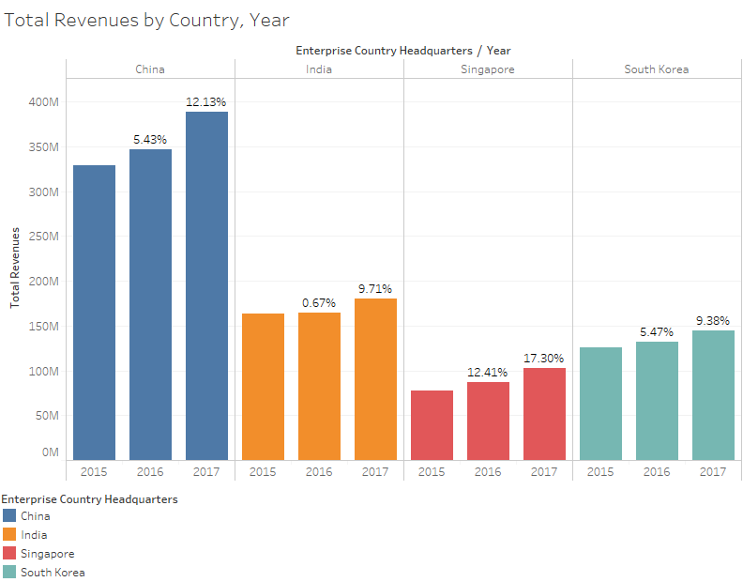
Data Set: Sample Analysis
China makes up the bulk of revenues with strong growth
Singapore the highest growth region YoY
India and SK have weak growth relatively, but still represent important markets by size

Slide 7
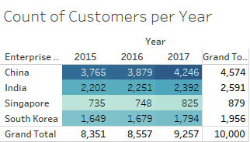
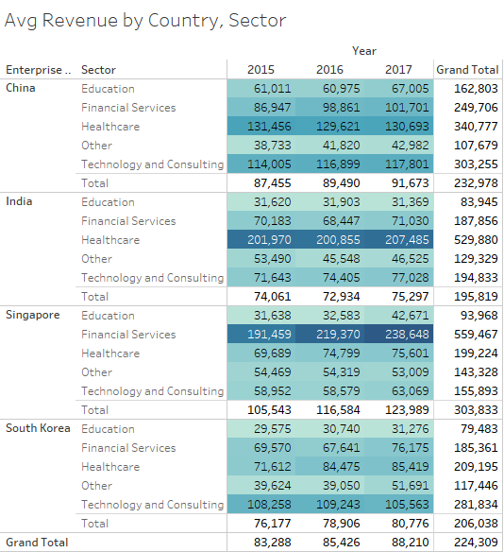
Data Set: Sample Analysis
Higher revenues in China driven by larger customer base; only region showing significant customer acquisition growth
Very high avg revenues per customer in specific sectors for Singapore (financial services), India (healthcare); China relatively balanced
Singapore financial services specifically shows very high growth in revenues YoY

Slide 8
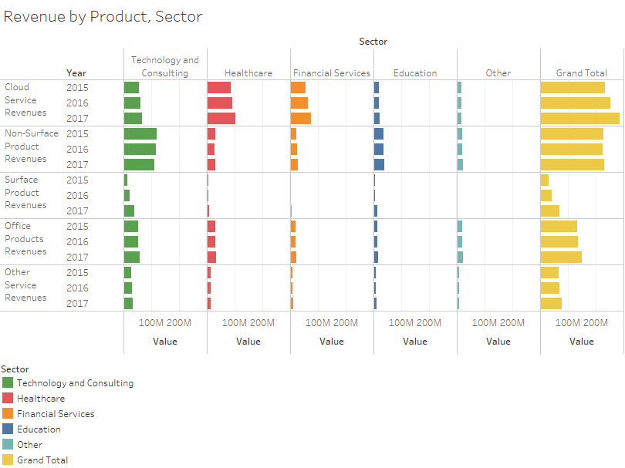
Data Set: Sample Analysis
Cloud clearly the most significant product for enterprises; high growth sector, driven by healthcare and financial services
Stagnant non-Surface revenues in high growth region indicate a need to address PC product strategy; particularly important as these #s exclude retail market

Slide 9
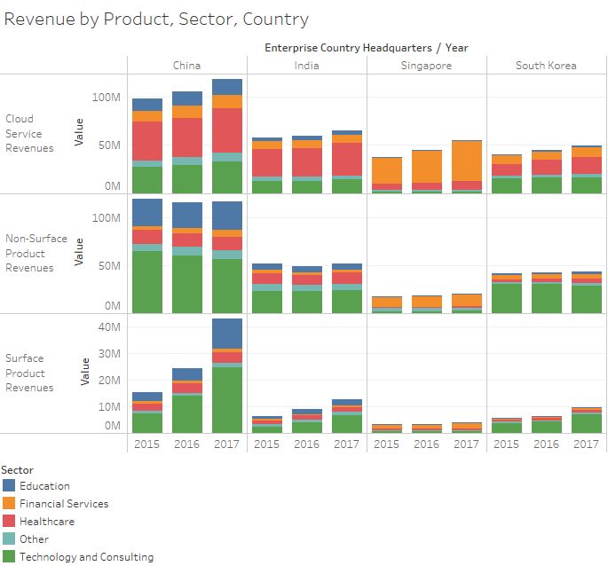
Data Set: Sample Analysis
Further analysis shows growth in various countries differs by sector and product
China has stagnant non-Surface revenues; massive growth in Surface revenues driven by tech+consulting, education sectors; average cloud growth for customer base
India and SK’s modest growth split between Surface and cloud
Singapore’s revenue growth driven entirely by financial services investing in cloud
Surface strategies should address these industries, countries; sectors requiring more dynamic PC products
Paired with growing + high avg revenue per customer implies cloud strategies should focus on customer acquisition

Slide 10
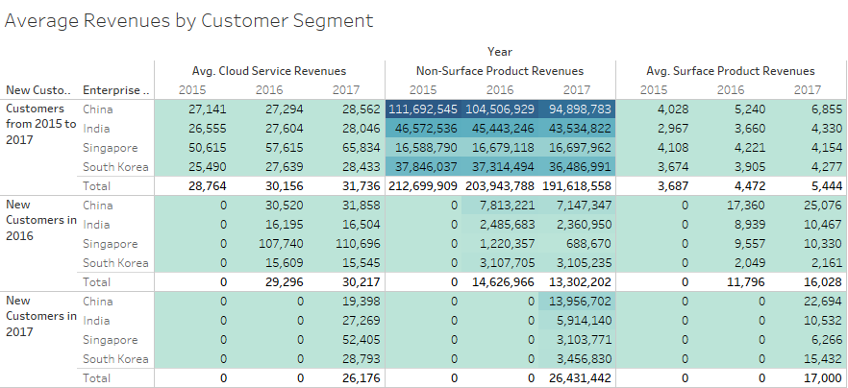
Data Set: Analysis
Cloud revenue growth comes primarily from new customers; possibly limited capacity to grow cloud service revenues organically?
Non-Surface revenues from existing customers are declining (!)
Revenues from existing Surface customers grow dramatically YoY; indication of a good product with very strong potential despite current revenues being small

Slide 11
Data Set: Conclusions
So which is the superior product to focus on? Hard to say -
Despite small current market, Surface products have potential to shore up weaknesses in traditional PC business; strategies focusing on aggressive customer acquisition and cross-selling in the right regions, tech+consulting & education markets should win
Cloud services generate significant revenues (larger pie), particularly from financial services and healthcare sectors; strong growth in a few regions, but currently limited up-selling on existing customers may limit long-term revenue potential
Most importantly – there is still lots of other ways to slice the data (using Workforce Size, cross-sales, share of wallet estimate via IT budgets, etc.). It will be interesting to see what students come up with, and how the data informs whatever strategy they take!

Slide 12
Questions/Suggestions?
We are releasing the case Wednesday afternoon and have attached the Tableau workbook and data set to play around with -
Thanks for reading, looking forward to the fun on Saturday

